Slide 1
Chapter 4 The Vivado Design Suite

Slide 2
Outline
Introduction
Installation and the Welcome Screen
Creating a New Project
Adding a Verilog File
Adding a VHDL File
Synthesizing the Project
Simulating the Project
Adding a Verilog Testbench File
Adding a VHDL Testbench File
Implementing the Synthesized Project
Programming the FPGA
Adding the Basys3 Board Constraint File to the Project
Programming the FPGA on the Basys3 Board
Adding the Arty Board Constraint File to the Project
Programming the FPGA on the Arty Board
Vivado Design Suite IP Management
Existing IP Blocks in Vivado
Generating a Custom IP

Slide 3
Introduction
Vivado design suite is the software environment we will be using.
Therefore, we will explain its properties starting from installation step.
Then, we will explain how to create a new project containing either Verilog or VHDL description of a simple digital system.
We will introduce tools necessary to synthesize and implement the HDL description.
We will explain how to program the FPGA on the Basys3 and Arty boards through Vivado.
We will introduce IP management methods in Vivado.

Slide 4
Installation and the Welcome Screen
As of writing the book, the Vivado design suite available in Xilinx’s web Page was version 2019.1. Therefore, we will use it throughout the book. After installation, Vivado starts as follows. This screen tells us that we are ready to go.

Slide 5
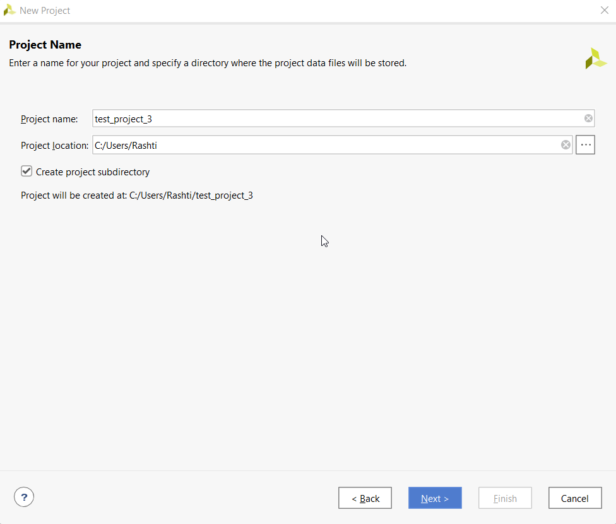
Creating a New Project
Create a new project window.

Slide 6
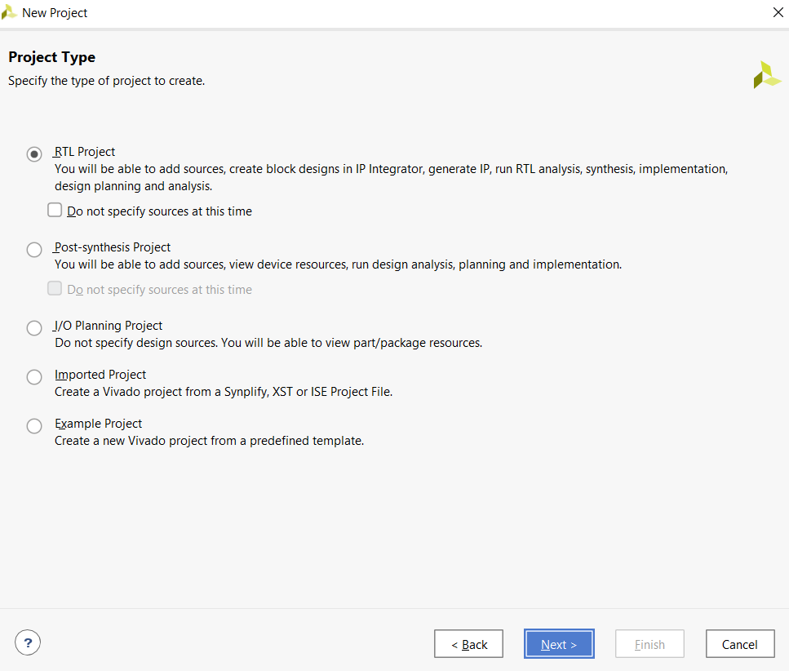
Creating a New Project
Add sources window.
Project type window
FPGA selection window.

Slide 7
Creating a New Project
Vivado project main window.

Slide 8
Creating a New Project
Add sources.
Add or create design sources.
Create source file.

Slide 9
Synthesizing the Project
Vivado after synthesizing the project.

Slide 10
Synthesizing the Project
Utilization report after synthesizing the project.
Schematic view of the design.
RTL schematic view of the design.

Slide 11
Simulating the Project
Simulation results in terms of input and output waveforms in time.
Setting simulation properties.
Final simulation results in the objects window.

Slide 12
Implementing the Synthesized Project
Vivado after implementing the project.

Slide 13
Programming the FPGA
Generate bitstream completion window.
The Hardware Manager window after Basys3 board is automatically detected.
Hardware programming window.

Slide 14
Vivado Design Suite IP Management
IP catalog window.
Create and package new IP window.

Slide 15
Vivado Design Suite IP Management
Package IP first system.
Modified IP catalog.

